Slide 1
Replication Project
Ellen Beattie - beattie1@tcd.ie

Slide 2
Can Warm Behaviour Mitigate the Negative Effect of Unfavourable Governmental Decisions on Citizens’ Trust?
Hansen, F. G. (2023). Journal of Experimental Political Science, 10(1), 62–75.

Slide 3
Theoretical Background
Context
Hypotheses
Citizen trust is fundamental in successful governance
Trust is often based on government performance and whether decisions fit individual preferences
There is some evidence that direct interactions with government staff has an impact on trust in the government
From social psychology, we understand the importance of interpersonal impressions when people make evaluative judgements
When citizens interact with government employees, what is the impact of the perceived traits of this employee and does this impact broader government trust?
H1: Citizens have lower trust in government the more unfavourable a decision is to the individual.
H2: The effect of decision favourability on citizens’ trust in government depends on whether bureaucrats show warmth in the decision-making process.
The negative effect of unfavourable decisions is weaker when bureaucrats show high warmth compared to showing low warmth.

Slide 4

Methodology
Experimental Groups
Method
 |  | Government Caseworker
 |  | Warmth = 0 | Warmth =1
Result of Nursing Home Application | Favourability = 0 | Group 4 Low Warmth + Unfavourable Decision | Group 1 High Warmth + Unfavourable Decision
 | Favourability = 1 | Group 3 Low Warmth + Favourable Decision | Group 2 High Warmth + Favourable Decision
Participants read one of four vignettes in which they imagine helping a close elderly relative apply for a place in a nursing home
Two features are manipulated in the vignettes: the description of the caseworker (high or low warmth) and decision on the application (accepted versus rejected).
Participants answered a series of demographic questions as well as rating the caseworker and the decision on a number of traits
Trust was then rated on a 0-10 scale depending on how much they trusted (a) the bureaucrat and (b) the municipality
“How much do you personally trust the
[municipality/the caseworker] to make the right decisions?”
2x2 survey experiment on representative sample of Danish Citizens (n = 1613)
0 | 1 | 2 | 3 | 4 | 5 | 6 | 7 | 8 | 9 | 10
‘No Trust At All’
‘Completely Trust’
Notes:
i.e. “the caseworker answered all your questions in a [warm and friendly / cold and unfriendly] manner … “
“based on the caseworker’s recommendation, the municipality has decided to [reject/approve] the application to enter a nursing home.

Slide 5
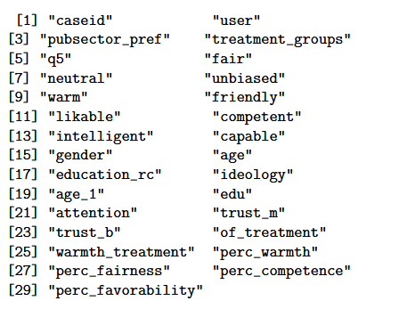
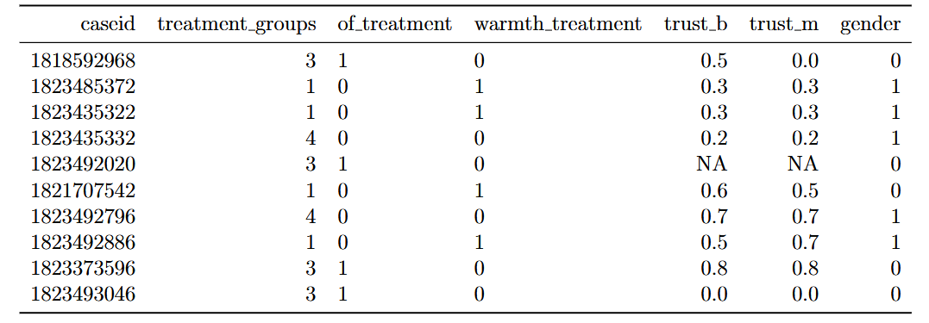
Data
Included Variables
Favourability of decision outcome
Warmth of Bureaucrat
Trust in Bureaucrat
Trust in Municipality
Notes:
The two experimental treatments were coded into dummy variables: ’
of treatment → 0 = Unfavourable, 1 = Favourable
warmth treatment → 0 = Low Warmth, 1 = High Warmth
Outcome variables ’trust b’ and ’trust m’ were rescaled from their original ‘0-10’ scale to a ‘0-1’ scale
E.g. 5 → 0.5
Other demographic variables and manipulation validity test measures were included

Slide 6
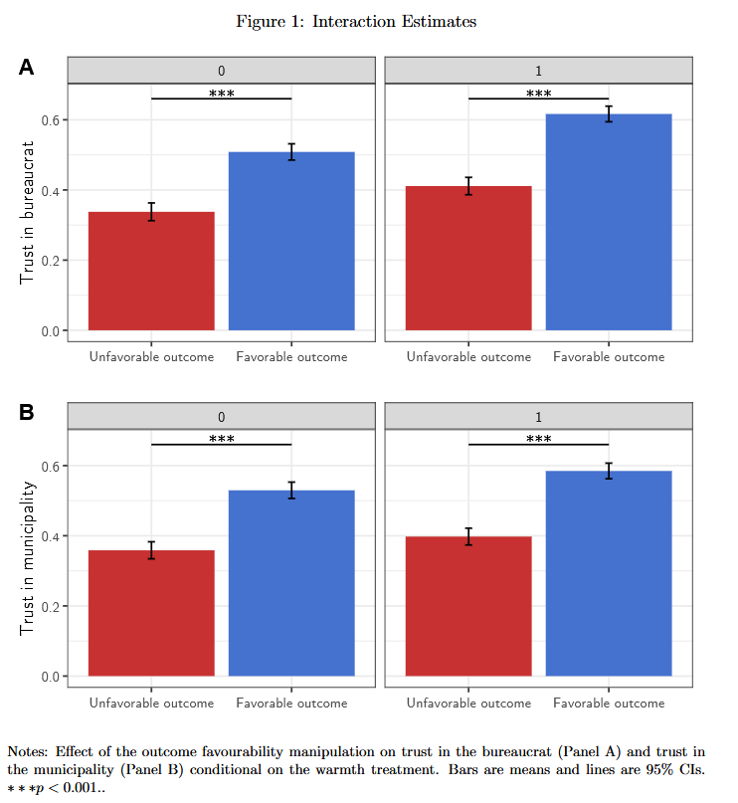
Overall Findings
Not Warm
Warm
The level of trust in the bureaucrat and the municipality increases based both on favourable outcomes and on warmth
Favourable outcome has a higher impact on trust than warmth in both cases
Results for the bureaucrat and the municipality are similar
Hansen concludes that:
“public leaders should be concerned about whether their employees behave in a warm manner if they want to build greater trust”
Bureaucrat
Municipality
Notes:
Experimental groups run L-R 4312. The other vairiables were used to validate that respondants accurately perceived the effect of warmth and outcome

Slide 7
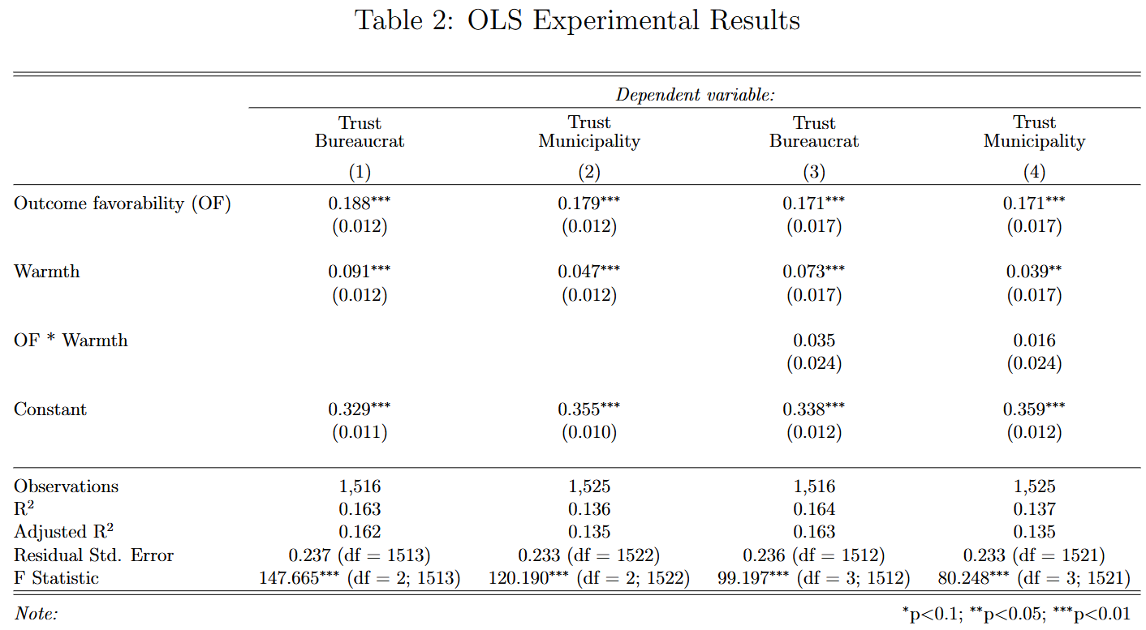
OLS Results
Positive outcome significantly increases level of trust in both bureaucrat and municipality by 18.8% points and 17.9% points respectively → supporting H1
The negative effect of outcome is not reduced when bureaucrats showed high warmth versus low warmth, as interaction terms are not significant for either outcome → not supporting H2
simple model
including interaction term

Slide 8
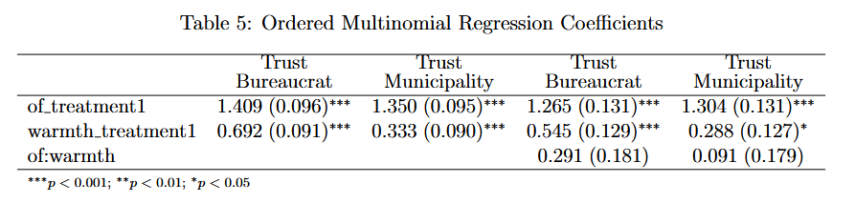
Extension - Ordered Multinomial Regression
Method
OLS assumes the outcome variable is continuous and unbounded but the 0-10 scale is ordinal and bounded
Four ordered multinomial regression models were run, treating the original outcomes levels 0-10 as separate categories on an ordinal scale
Regression coefficients are the change in the log-odds of being in a higher category in each treatment
Outcome
The positive impact of the treatments and insignificant interaction term are consistent with the OLS models
Notes:
Although the interpretation is slightly less intuitive than OLS, this approach does make movement across the ordinal responses clear
To obtain more interpretable results, the predicted probabilities of categories for each treatment group were calculated and then converted into an expected trust measure.
E.g. For model 1 and holding all else constant, participants in the warmth condition have on average about 2 times higher odds of choosing a higher trust category than those not in the warmth treatment ($OR = e^{0.692} ≈ 1.99$)
E.g. For Unfavourable Low Warmth the Trust B in the simple model predicted mean trust score was 3.25 compared to the observed 3.38.

Slide 9
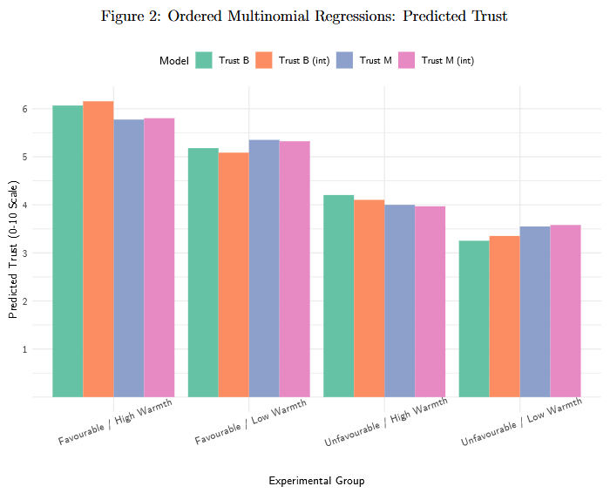
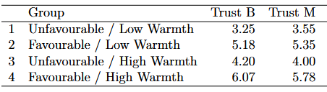
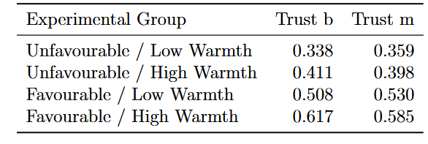
Extension - Ordered Multinomial Regression
Predicted trust levels for each experimental group were calculated using the models predicted probabilities
The predicted trust values were similar to the experimental group means
This approach validates OLS findings and makes predictions in original scale
Predicted Group Trust Average
Experimental Group Trust Average

Slide 10
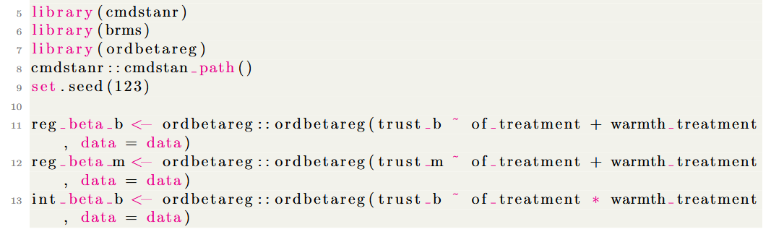
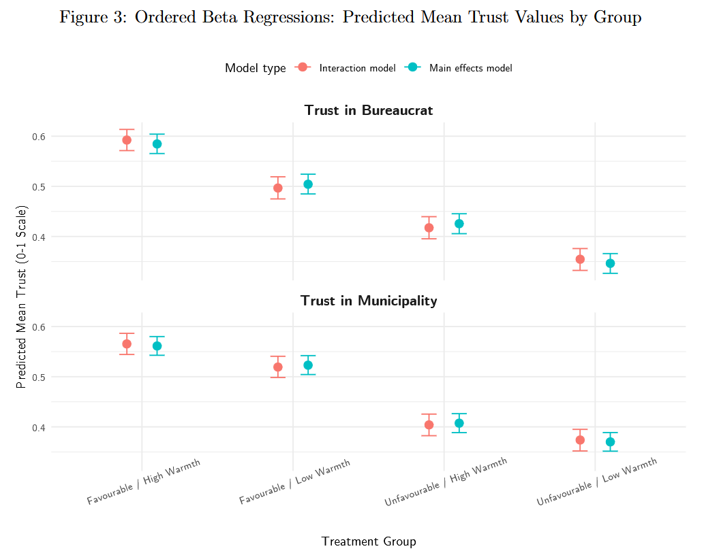
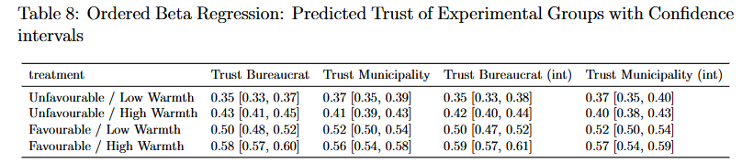
Extension - Ordered Beta Regression
Ordered Beta Regression is an alternative type of regression explicitly designed for outcome data that has an ordinal and bounded structure.
It combines beta regression defined for any bounded continuous scale and the ordered logit that uses discrete categories.
It is beneficial as it produces intelligible estimates that respect the bounds of the outcome variable
The package ’ordbetareg’ estimates a Bayesian implementation finding the posterior distribution (using a Markov chain Monte Carlo)
The predicted mean trust values for the groups were calculated from posterior predictions and show very similar prediction to the real means
Notes:
as it assumes there is an unobserved latent scale that is mapped with ordinal cut-offs for the scaled ratings.

Slide 11
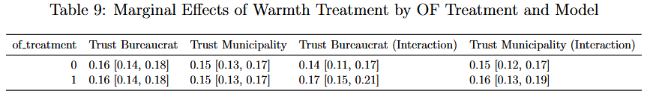
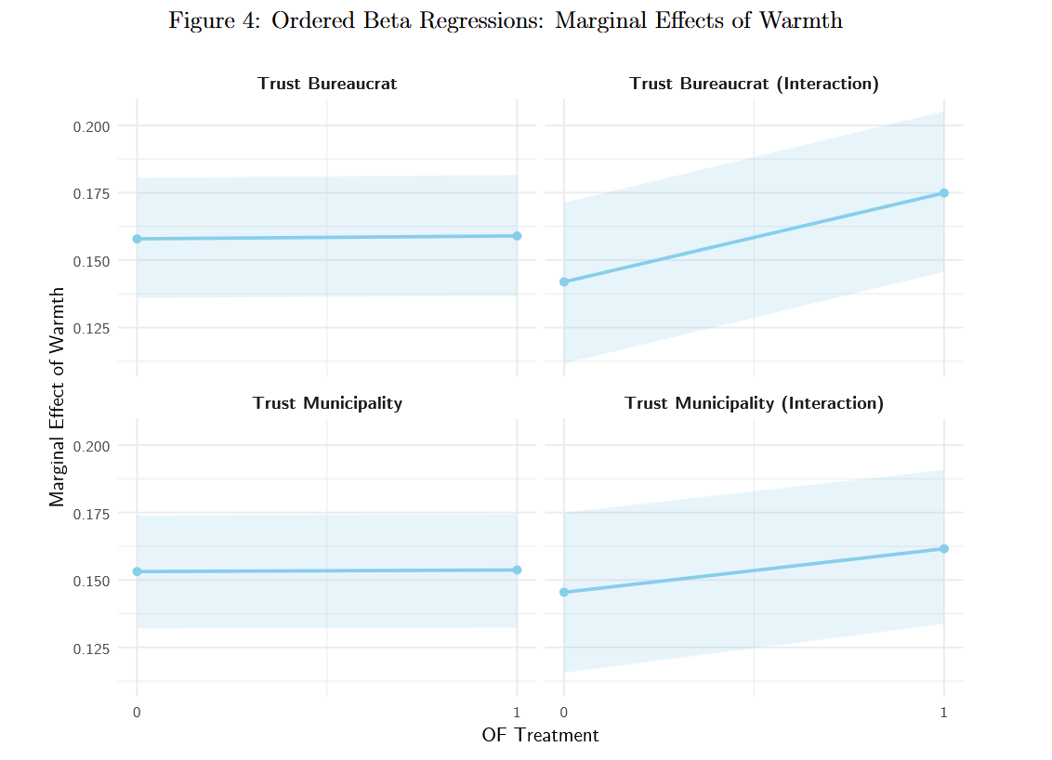
Conditional Marginal Effects Using Beta Regression
The marginal effect of Warmth was calculated to understand the difference in expected trust when the warmth treatment is applied, holding the outcome favourability constant
The results from the ordered beta predicted trust values (0-1) suggest effect of warmth increases trust in the bureaucrat and the municipality by 0.16 and 0.15 points on average.
The effect of warmth is slightly stronger in a favourable outcome scenario indicating that warmth may be more effective in positive contexts
Notes:
Created predictions for 4 treatment conditions using posterior

Slide 12
Conclusion
The original study was replicated successfully confirming the results that outcome favourability and warmth strongly influence citizens’ trust in government.
Two alternative methods were applied: an ordered multinomial and an ordered beta regression
The ordered multinomial reflected the ordinal nature of the data and found similar treatment effects to the OLS model, made accurate predicted values and further supported the original findings that there is not a significant interaction effect
The ordered beta regression using Bayesian estimation reaffirmed the previous findings but with an approach that is specifically designed for bounded ordinal nature of the outcome variable

Slide 13

Thank you for listening!
Any Questions?

